Slide 1
HEALTH CARE MANAGEMENT SYSTEM SIMULATION
PRECIOUS ANYANGU FRIDA
+254 103487402
@anyanguprecious@gmail.com

Slide 2
INTRODUCTION
A Healthcare Management System simulation for managing clients
and health programs/services.
Aim
Manage patients, programs, and enrollments efficiently.
Key Focus Areas:
Registration, Enrollment, Program Management.

Slide 3
Assumptions of the task
Patient Registration vs Enrollment
Patients can be registered in the system without being enrolled in any program.
Dynamic Patient Management
Patients can be deleted (supporting either soft delete or hard delete based on system requirements).
Patients can be unenrolled from programs directly through their profile page.
Program Uniqueness
Each program must have a unique name (e.g., no duplicate programs like "TB Program").
Attempts to create a program with an existing name should trigger an alert or error message.
Program Visibility
• Users can view all available programs through a designated endpoint (e.g., GET /api/programs).

Slide 4
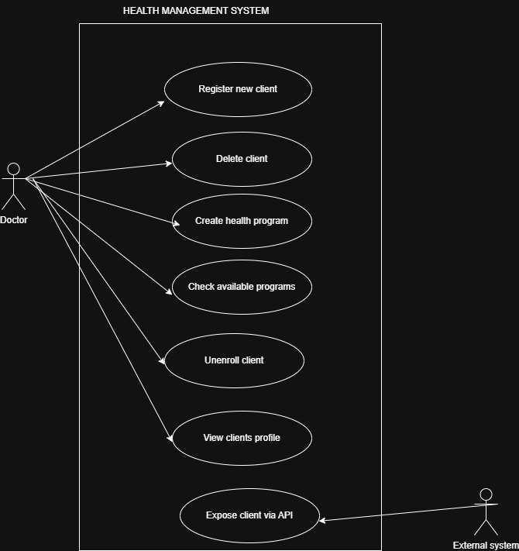
USECASE DIAGRAM
Represents user interactions with the system.
Main actors: External system and Doctor
Main actions: Register, Enroll, View Programs, Manage Enrollments.

Slide 5
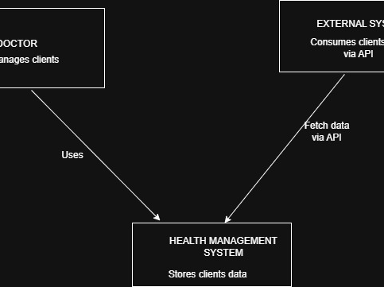
SYSTEM ARCHITECTURE
Frontend: User Interface (e.g., web app)
Backend: Flask API managing business logic
Database: (In simulation, in-memory lists; in real-world, SQL/NoSQL database)
For simulation, we use in-memory data structures to mimic database behavior.

Slide 6
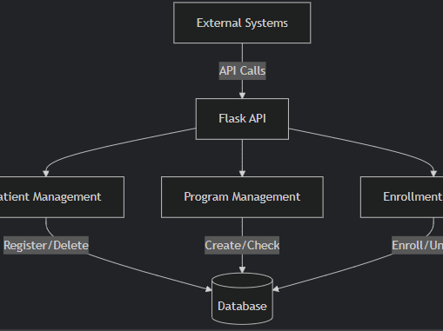
SOLUTION
Core Functionalities:
User Authentication (Login, Token-based Access Control)
Patient Registration
Program Creation
Client Enrollment
Profile and Enrollment Management
Program Listing
Technologies Used:
Flask (Web Framework)
Flask-JWT-Extended (Authentication)
Python (Programming Language)

Slide 7
CONCLUSION
The system supports flexible patient and program management.
It ensures secure, organized, and scalable healthcare simulations.
Future enhancements could include real databases, role-based access control, and audit logs.
Enhanced User Interface (UI):
Design a more user-friendly and responsive front-end (using frameworks like React, Vue, or Bootstrap).
Improve form validation, error handling, and navigation to make the system smoother and more intuitive for users.
Add visual feedback like success messages, loading indicators, and error alerts.
Ensure mobile responsiveness so the app looks good on phones and tablets.

Slide 8
HEALTHCARE MANAGEMENT SYSTEM SIMULATION THANK YOU

